Slide 1
SCIF Cleanroom Orientation
Anand Gadre
Director
Stem Cell Instrumentation Foundry (SCIF)
University of California, Merced
5200 N. Lake Road
Merced, CA 95343
Phone: (209) 658-3879
Fax: (209) 228 4424
Email: agadre@ucmerced.edu

Slide 2
Purpose
Orient new members to the SCIF cleanroom
Familiarize new users to the SCIF Cleanroom policy
Cleanroom access
Cleanroom standard operating procedures (SOP
Safety
SCIF Website

Slide 3
Introduction
All prospective cleanroom users are required to complete the following training sessions.
“General Chemical Lab Safety Training” provided by Environmental Health and Safety (EH&S).
“Hazardous Waste Safety Training” provided by EH&S.
“Cleanroom Orientation” provided by the SCIF Staff
“Process Specific Training” provided by PIs and the SCIF Staff.
Submission of signed SCIF Disclosures.

Slide 4
General Rules and Restrictions
The following Rules are to be observed by all persons qualified to work in the SCIF:
Only Individual qualified through the SCIF Training program are allowed to enter the cleanroom.
No makeup shall be worn inside the cleanroom
Food and drinks are prohibited in the cleanroom.
No Smoking is allowed 30 minutes before entering the cleanroom.
No Chewing Gum allowed in the cleanroom.
Avoid wearing contacts. Contacts can absorb vapors or trap chemicals in the space between the lens and the eye. Contacts may thus interfere with flushing the eye with water in case of an accident.
Clothing Requirements. Everyone must wear full-length pants, shoes made of leather that completely cover the foot (no sandals, no open-toed shoes).

Slide 5
General Rules and Restrictions
Only use pens. Pencils are not allowed in the cleanroom.
Hair nets, shoe covers, safety glasses, mustache/beard nets, and gloves must be worn at ALL times.
Nonessential items (tools, books, backpacks etc…) must be kept outside the lab or in the gowning room area.
Try not to sneeze, cough or breathe directly on a clean surface or wafer/substrate.
Do not let your skin touch any surface in the cleanroom. Do not touch your face with your gloved hand. Do not touch the outside of a glove (expect for the wrist edge) with your ungloved hand.
Do not enter the service area without permission.
Always clean up your work area before you leave.

Slide 6
General Rules and Restrictions
You must have a complete understanding of all the chemicals at the wet benches. Read the wet benches SOP before you use them.
You must have a complete understanding of equipment operation and become a certified user before you process, read the SOPs and request training sessions well in advance before you schedule your work in the cleanroom.
Review the MSDS sheets of chemicals before you use them so you understand the hazards, risks and methods for responding to an incident.
****YOU MUST NEVER WORK ALONE**** You must have a buddy who has been qualified through the Cleanroom Access training program. This person should be qualified to assist you in case of a incident.

Slide 7
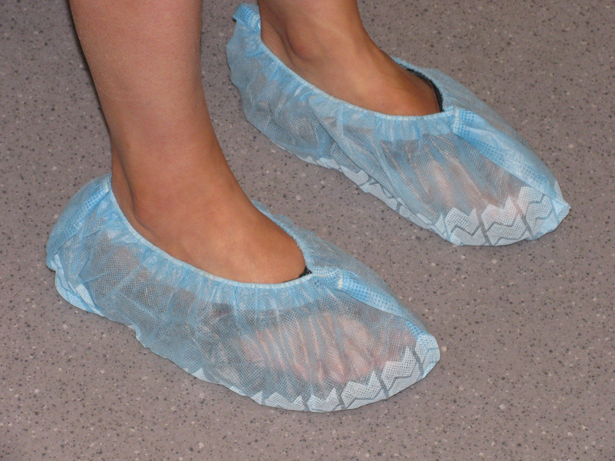
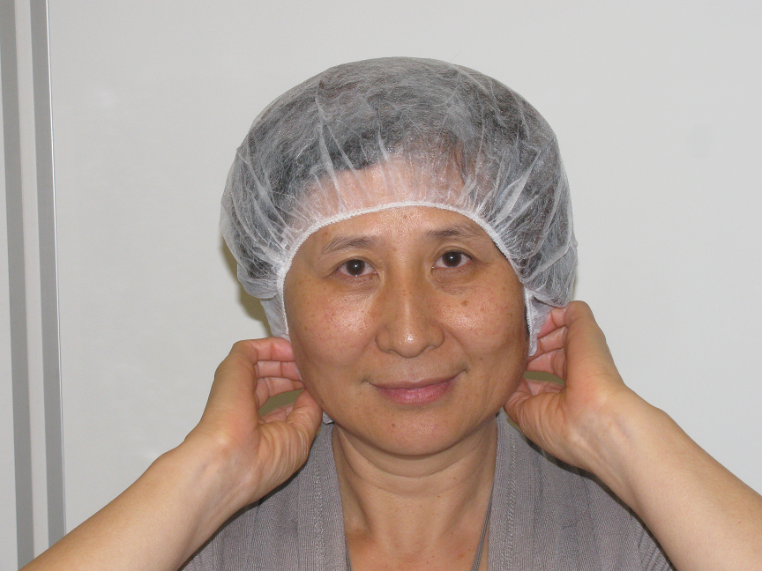
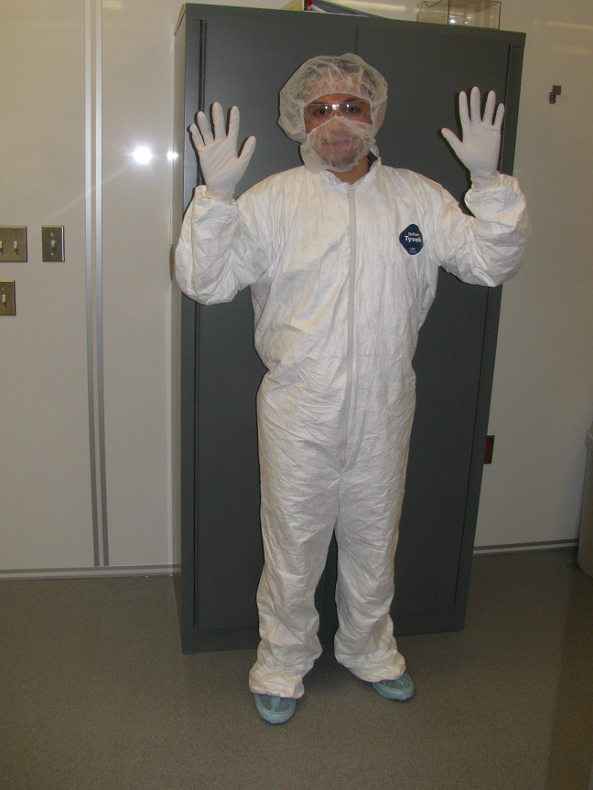
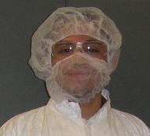
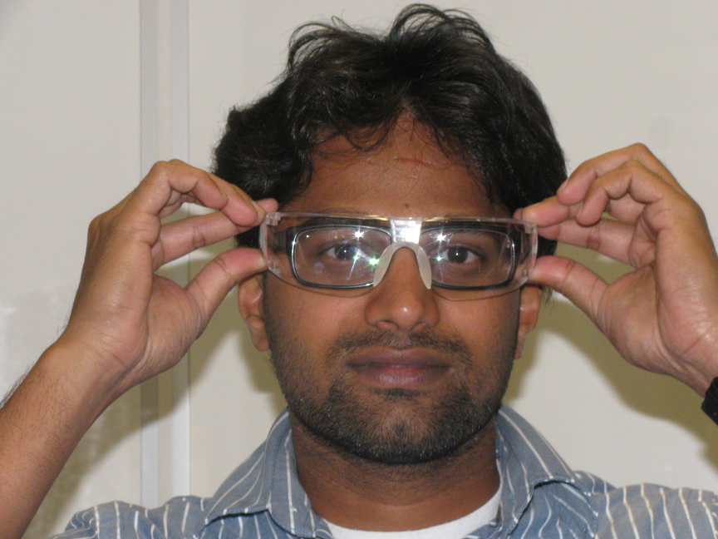
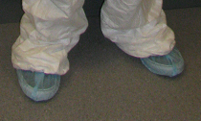
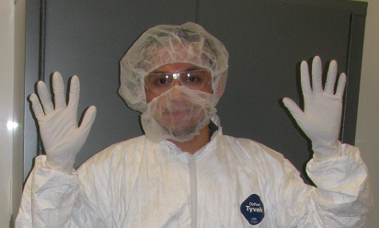
Procedures for entering the cleanroom

Slide 8
Procedures for exiting the cleanroom

Slide 9
Emergency Equipment
Safety Showers
Purpose: For chemical decontamination of a person and their clothing.
Location: Class 1000 area, outside and inside the wet lab (room 154).

Slide 10
Emergency Equipment
Eye Wash Station
Purpose: For mitigating a chemical splash in the eye.
Location: Class 1000 area, Outside and inside the wet labs (Room 154).

Slide 11
Emergency Equipment
Fire Extinguishers
Use: For fires smaller than a waste paper basket by those who are trained to use them.
Location: Class 100 area Class 1000 area, Wet lab area.

Slide 12
Emergency Equipment
First Aid Kit
Use: For minor injuries and minor burns pain relief
Location: In the gowning cabinet.

Slide 13
Emergency Equipment
MSDS Book
Use: All users seeking information on chemical hazards and precautions.
Location: In the gowning area. You may also access the MSDS library online at www.scif.ucmerced.edu

Slide 14
Emergency Equipment
Telephone
Use: For contacting help in case of emergency (Dial 228-2986 and after hours 228-4128) or use speed dial.
Location: In the gowning area.

Slide 15
Safety Equipment
Name: Personal Protective Equipment (PPE).
Purpose: For personal protection against chemical spills.
Use: You must wear the following items (in addition to cleanroom apparel) when working with chemicals:
Full-sleeved aprons
Face Shields
Chemical Resistant gloves
Location: By the wet benches and lithography room hanged on the wall.
WARNING: These items are chemical resistant, NOT chemical proof. Do not immerse gloves in chemicals!

Slide 16
Specific Rules When Working with Chemicals
DO NOT use a chemical without first reading its MSDS.
Use the dedicated beakers only and label the chemicals and processes used on the beaker.
Wear personal protective equipment in addition to required cleanroom apparel.
Do not work with acids or bases in the solvent hoods.
Do not work with solvents in the acid or base hoods.
Use only one bottle of chemical at a time and store it back in its chemical cabinet when not in use.
Do not pour used chemicals back into a new bottle. For chemical waste disposal rules read the Wet Benches SOP
Make sure that gloves are clean and dry before transferring chemicals to or from the bench.

Slide 17
Specific Rules When Working with Chemicals
Put the cap back on each chemical bottle securely. Clean the outside of the bottle of residual chemicals (clean and dry) before returning to storage.
Do not wear safety apparel outside of wet bench areas unless working under emergency or HAZMAT cleanup conditions
Make sure that all PPE is clean and dry before returning to storage areas

Slide 18
EMERGENCY RESPONSES

Slide 19
Emergency Response: Chemical Spill Clean-Up
A Minor Spill (excluding HF)
A minor spill is one that is not toxic and does not spread rapidly or poses a health, fire or property risk, and is less than 1/2 gallon of liquid.
The lab occupant responsible for the spill is expected to clean up simple spills. Please read the Chemical Spills & Injuries SOP available online at www.scif.ucmerced.edu

Slide 20
Emergency Response: Chemical Spill Clean-Up
A Minor Spill (excluding HF)
To clean up minor spills:
Wear proper Personal Protective Equipment (PPE) in addition to cleanroom apparel: PPE may include full-sleeved apron, face shield, a respirator and chemical resistant gloves.
Review the MSDS sheet for the chemical hazards. Contain spill following instructions listed on the “Chemical Spills and Injuries SOP”.
Minor spills may be contained and absorbed using the appropriate absorbents available in the cleanroom. Refer to SOP
If unsure how to clean the spill, call a cleanroom staff member and ask your cleanroom buddy to stay by the spill and alert others while you go seek assistance.

Slide 21
Emergency Response: Chemical Spill Clean-Up
A Major Spill
A large or toxic spill is a high hazard emergency. A spill is considered hazardous if it is more than a 1/2 gallon of liquid or if it includes any amount of HF. A toxic spill is one that spreads rapidly and poses an immediate health, fire, or property risk.
Call for help (Dial emergency number)
Alert others of the need to evacuate the cleanroom
DO NOT De-gown
Inform and Meet cleanroom staff ASAP.

Slide 22
Mercury Release
When a high pressure mercury lamp explodes toxic gas is released; this is an extremely high hazardous situation. (Mercury lamps are located in all mask aligners and steppers)
Evacuate the building as quickly as possible and activate a HAZMAT alarm (push blue button) on your way out.
DO NOT try to finish an experiment.
DO alert others
DO-NOT De-gown
Meet at the designated evacuation spot and inform staff of the incident.

Slide 23
Emergency Response: Chemical Exposure
For a Minor Chemical Exposure on Skin (Other than HF):
Immediately place affected area under running water for 15 minutes.
Remove any jewelry or clothes that may contain the residue.
After washing DO NOT dry skin.
FOR PERSON HELPING THE VICTIM:
Be sure you are wearing appropriate protective apparel before helping the chemical contact victim.
Call Cleanroom Staff to inform them of the incident and ask for advice on how to treat it. Seek medical assistance if recommended.
Obtain the MSDS and hand it to the ER team.

Slide 24
Emergency Response: Chemical Exposure
For Flammable Solids on Skin:
Brush off as much of the solid as possible, then treat as a minor/major liquid spill on skin.
For Chemical Splash In Eyes:
Flush eyes with eye wash fountain for 15 minutes or until ER ambulance arrives.
While flushing, hold eyelids open with hands and rotate eyeball up, down, and side to side to ensure all areas are rinsed.
FOR PERSON HELPING THE VICTIM:
Be sure you are wearing appropriate protective apparel before helping the chemical contact victim.
Help victim get to the eye wash station and activate the eye wash fountain for him/her.
Call 228-2986 adn after hours 228-4128 to request an ambulance for the victim
Get the MSDS and hand it to the ER team.

Slide 25
Emergency Response: Other Incidences
Chemical Inhalation:
Close containers and attempt to move worker to an area where fresh air is available.
Call poison control and seek medical attention if advised by Poison Control. In extreme situations resuscitate with rescue breathing, shock prevention treatment (victim lying down, lightly covered to preserve body heat and comforted to reduce anxiety).
If symptoms such as headaches, nose or throat irritation, dizziness, or drowsiness persist, seek medical attention.

Slide 26
Emergency Response: Fire Alarm
If the Fire Alarm Sounds
YOU MUST exit the building immediately through the nearest door.
DO NOT try to finish an experiment.
DO NOT try to figure out why the alarm is sounding.
DO NOT attempt to de-gown.
DO warn others in your vicinity of the need to evacuate the building.
After evacuation all cleanroom users and staff must meet at the designated evacuation spot.

Slide 27
Responsibilities
The procedures and precautions outlined in this presentation are for the purpose of protecting the SCIF cleanroom workers and equipment. Anyone found in violation of the aforementioned procedures will suffer consequences, which may include a loss of privileges or even a complete loss of access to the cleanroom. In order to prevent such consequences, it is your responsibility to review the SCIF SOPs.

Slide 28
When do I get my access?
Before your orientation / training is completed you need to:
Take the Cleanroom tour
Understand a cleanroom layout sketch (to familiarize yourself with different safety features inside cleanroom)

Slide 29
THANK YOU
Please FAB Safely!

